Slide 1
COVID-19 Vaccinations Trend Analysis
Chethan Kumar D K

Slide 2
Table of Contents
Aim
Introduction
Problem statement
Methodology
Analysis (Data sheets pertaining to it)
Insights
Recommendations
Conclusions
Notes:
Insert a map of your country.

Slide 3
Aim
The aim of this project is to analyze the global trend of COVID-19 vaccinations and provide insights on the progress of vaccinations across different countries based on people who have vaccinated and fully vaccinated in the year 2021 - 2022.
Notes:
Insert a picture of one of the geographic features of your country.

Slide 4
Introduction
The COVID-19 pandemic has brought about unprecedented challenges to the world.
One of the most effective ways to control the spread of this disease is through the development and distribution of vaccines. Vaccines are essential in building immunity against the virus and preventing future outbreaks.
This project focuses on analyzing the trend of COVID-19 vaccinations worldwide. The objective is to identify any patterns or trends in the data.
Notes:
Insert a picture illustrating a season in your country.

Slide 5
Problem Statement
This project aims to analyze the trend of COVID-19 vaccinations globally and identify any patterns, insights, or trends that could help policymakers make informed decisions in different Countries,
Based on “how many people are Vaccinated or fully Vaccinated” and “Total Vaccination per hundred”, “People Vaccination per hundred”, and “Daily vaccinations per Million” in 2021 and 2022.
Notes:
Insert a picture of an animal and or plant found in your country.

Slide 6
Methodology
Data Importing
Data cleaning
Data visualization:
Data analysis
Notes:
Add key points in the history of your country to the timeline.

Slide 7
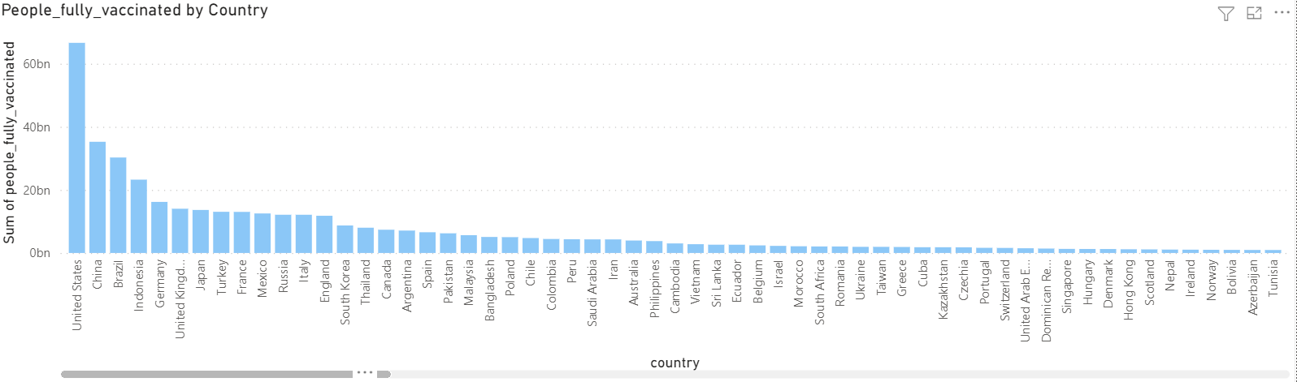
Visualization and Analysis
Chart shows that “The People Fully Vaccinated” by “Country”.
“US” has highest People who are Fully Vaccinated.
Notes:
Insert a picture illustrating a custom or tradition here.

Slide 8
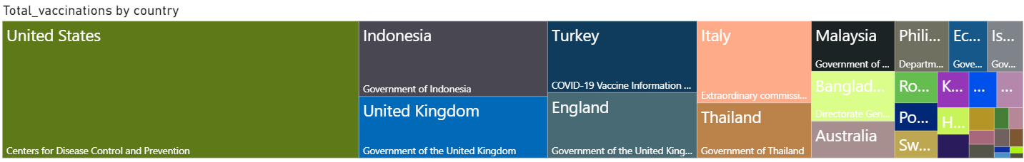
Visualization and Analysis
Chart shows the “The Total Vaccinations” by “Country”.
“US” has highest Total Vaccinations.
Notes:
Insert a picture illustrating a custom or tradition here.

Slide 9
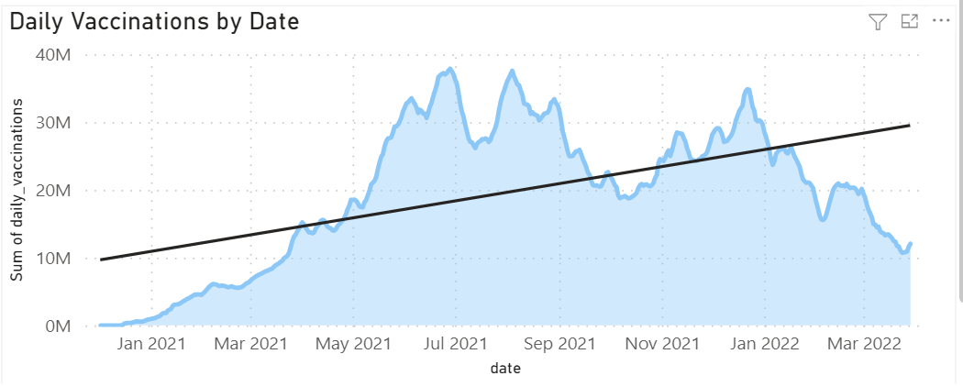
Visualization and Analysis
Chart shows the Daily vaccinations vs Date.
July-2021, Aug-2021, Sept-2021, Jan-2022 highest no. of vaccinations.
Notes:
Insert a picture illustrating a custom or tradition here.

Slide 10
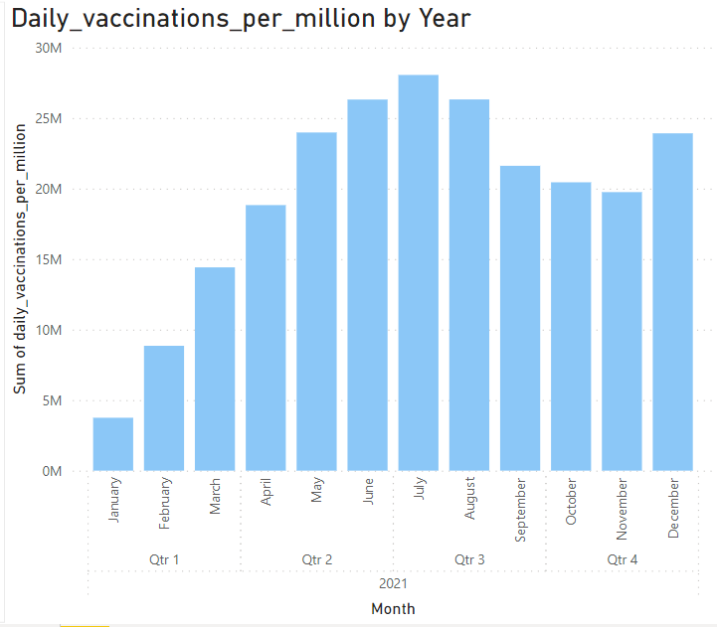
Visualization and Analysis
Chart shows the Daily vaccinations per million vs Date.
July-2021 highest no. of vaccinations per million.
Notes:
Insert a picture illustrating a custom or tradition here.

Slide 11
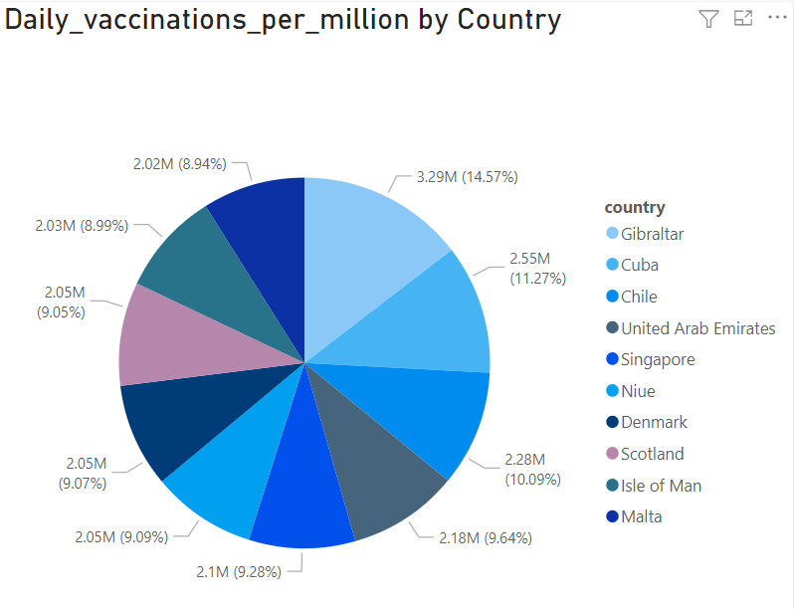
Visualization and Analysis
Chart shows the Daily vaccinations per million vs Top 10 Country.
Gibraltar has done highest no. of vaccinations per million
Notes:
Insert a picture illustrating a custom or tradition here.

Slide 12
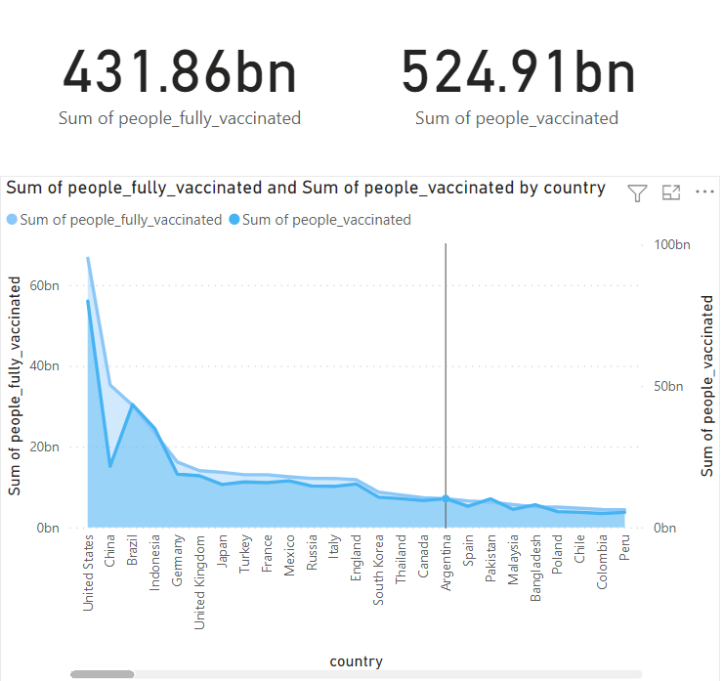
Visualization and Analysis
Chart shows Sum of people vaccinated and Sum of people fully vaccinated for individual country.
United States had the highest Sum of people fully vaccinated and Pitcairn had the lowest.
Notes:
Insert a picture illustrating a custom or tradition here.

Slide 13
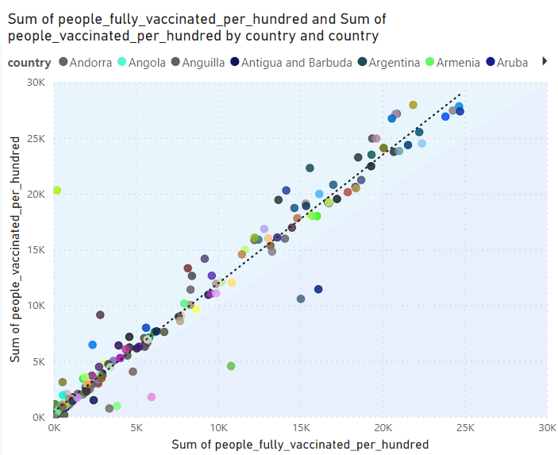
Visualization and Analysis
Chart shows the sum of people vaccinated per hundred and Sum of people fully vaccinated per hundred for individual country.
Malta had the highest Sum of people fully vaccinated per hundred and Wales had the highest Sum of people vaccinated per hundred.
Notes:
Insert a picture illustrating a custom or tradition here.

Slide 14
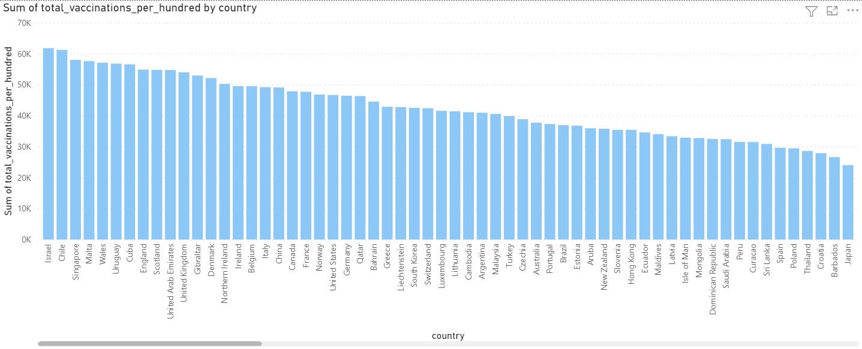
Visualization and Analysis
Chart shows “The Total Vaccinations per Hundred” by “Country”.
In which “Israel” has highest Total Vaccinations per Hundred.
Notes:
Insert a picture illustrating a custom or tradition here.

Slide 15
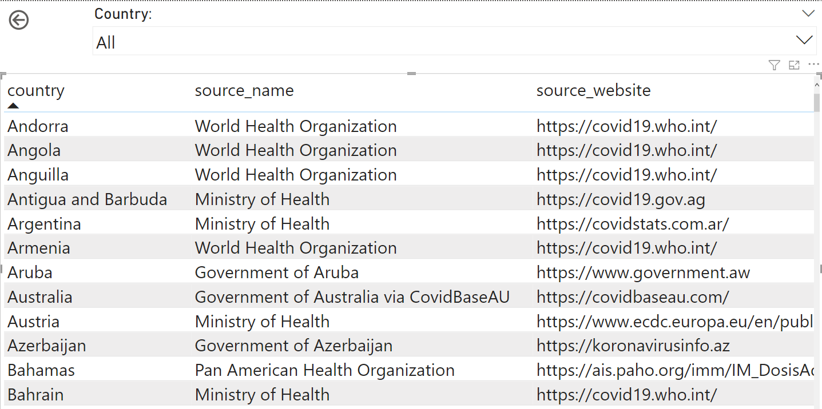
Visualization and Analysis
Table shows the Country wise Source for vaccination.
Notes:
Insert a picture illustrating a custom or tradition here.

Slide 16
Insights
The vaccination efforts vary widely across different countries and regions.
Some countries have made significant progress in vaccination, while others are lagging behind.
We can see the Analyze of the sum of daily vaccinating details, fully vaccinating and vaccinating people details based on different countries and Date from the visualization.
Notes:
Insert a picture of the head leader of your country.

Slide 17
Recommendations
Improve the efficiency of the vaccination program in countries with low vaccination rates.
Increase public awareness of the importance of vaccination and address any concerns or misconceptions about vaccines.
Collect day to day reports for better analysis.
Like this dataset we can perform operations with various categories, city-wise or region-wise.
Collect city-wise and region-wise data to analyze, to get more in-depth insights.
Notes:
Insert a picture of the head leader of your country.

Slide 18
Conclusions
The analysis of the COVID-19 vaccination trend data provides valuable insights into the progress of vaccination across different countries.
The analysis shows that vaccination efforts vary widely, and there is a need to improve the efficiency of the vaccination program in some regions.
The analysis also highlights the critical role of public awareness in promoting vaccination efforts.
Overall, this project demonstrates the importance of monitoring and analyzing vaccination trend data to identify trends, patterns, and insights that can inform policy decisions and improve vaccination efforts.
Notes:
Insert a picture of the head leader of your country.

Slide 19
Thank you
Notes:
Insert a picture of one of the points of interest for your country.

